Slide 1
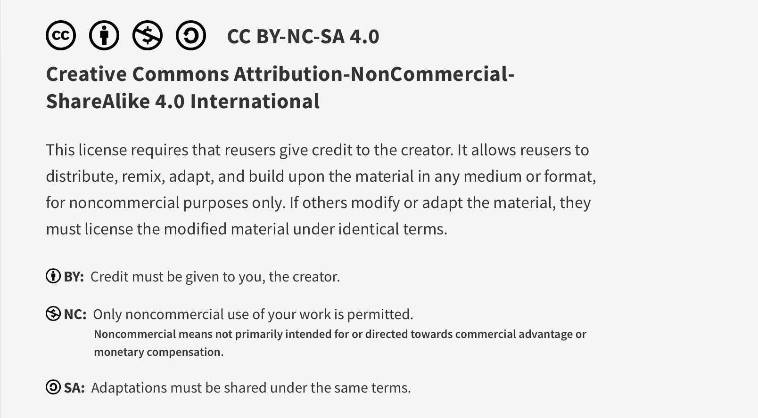
This work is licensed under CC BY-NC-SA 4.0. To view a copy of this license, visit: https://creativecommons.org/licenses/by-nc-sa/4.0/

Slide 2

Systems Approach to Quality and Safety
Lucie Filteau, MD, FRCPC
PGY 2-4 Academic Half Day
QPS Series

Slide 3
Ottawa Anesthesia QPS Curriculum
PGY 1
PGY 2-4
Intro to Safety
Handover
Stress and Substance Abuse
IPAC Session
Positioning Workshop
Systems Thinking and Design
Intro to Quality Improvement 1
Intro to Quality Improvement 2
Human Factors
Resource Stewardship
Situational Awareness, Teamwork and Communication

Slide 4
Group Session Plan
Large group discussion
Video
Pre-session material
Smaller groups:
Explore system design in the context of a periop setting (TRIZ exercise)
Explore possible contributing factors for an A/E using an analysis tool (Fishbone)

Slide 5

TEDx Video: Doctors Make Mistakes

Slide 6
Pre-Session Material Review
Complex systems
Organization Culture
Process of adverse event investigation
A/E investigation tools
Any comments or questions?

Slide 7
Small Group Brainstorming Exercise
Design a system where a patient undergoing surgery gets the wrong medication 100% of the time
(Pick a group rep to report ideas back to larger group)

Slide 8
“TRIZ” Exercise
Russian acronym for “Theory of Inventive Problem Solving”
Method of systems analysis through evaluation of contradictions to promote creative brainstorming
Designing a system for the worst possible outcome highlights the flaws in our current system
Then “reverse engineer” for system improvements

Slide 9
Share your results…

Slide 10
Wrong Medication 100% of the Time:
Random storage system, variable between sites
Medication drawers restocked by untrained staff (errors)
Constant med substitutions without warning
No communication with pharmacy to avert purchasing of look alikes
Look alike vials, dangerously co-located
Med prep in done with multiple distractions
No/insufficient/cheap medication labels, or lack of labelling best practice
Multiple providers with different workflow practices
No vial scanning ability
Rushed, emergency situations in dark environment with fatigued staff

Slide 11
Small Group Exercise 2: Root Cause Analysis
Scenario:
At the end of a patient’s prolonged laparoscopic surgery (yesterday), the drapes were removed and the patient’s right hand was noted to be extremely swollen, cold and pale. She was quickly diagnosed with compartment syndrome, as a result of an interstitial IV, and fasciotomies were performed. The patient is now on the ward and recovering from both surgeries.
You are the investigation team. Pick another group rep. Brainstorm re the possible contributing factors to this A/E. Use the Fishbone tool to assist you.

Slide 12
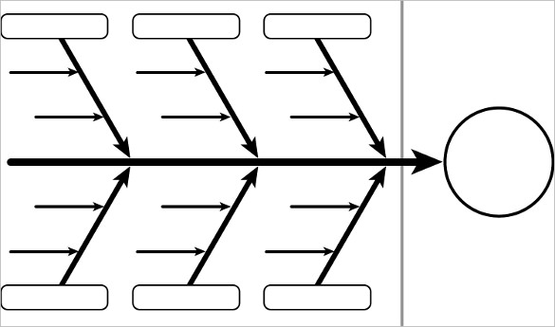
Fishbone/Ishikawa Diagram
Categories:
People
Environment
Equipment
Materials Mgmt
Methods
Notes:
Kaoru Ishikawa: THIS IS A TEAM EFFORT, MUST CONSULT MULTIDISCIPLINARY TEAM AND YOUR FRONT LINE!!

Slide 13
Share your results…

Slide 14
Possible contributors
People
Insufficient knowledge/training/supervision
Fatigue, distractions
Inadequate communication b/w providers
Environment
Inadequate assistance with excessive workload (overwhelmed staff)
Production pressure, emergency situation (inadequate time)
Equipment
Saline lock confuses picture (ambiguous IV check)
IV pump driving pressure, alarm settings
Methods and Process
Workflow not well established (IV check not prioritized)
Arm tucking practice : Necessary (pros/cons)? Done with care?

Slide 15

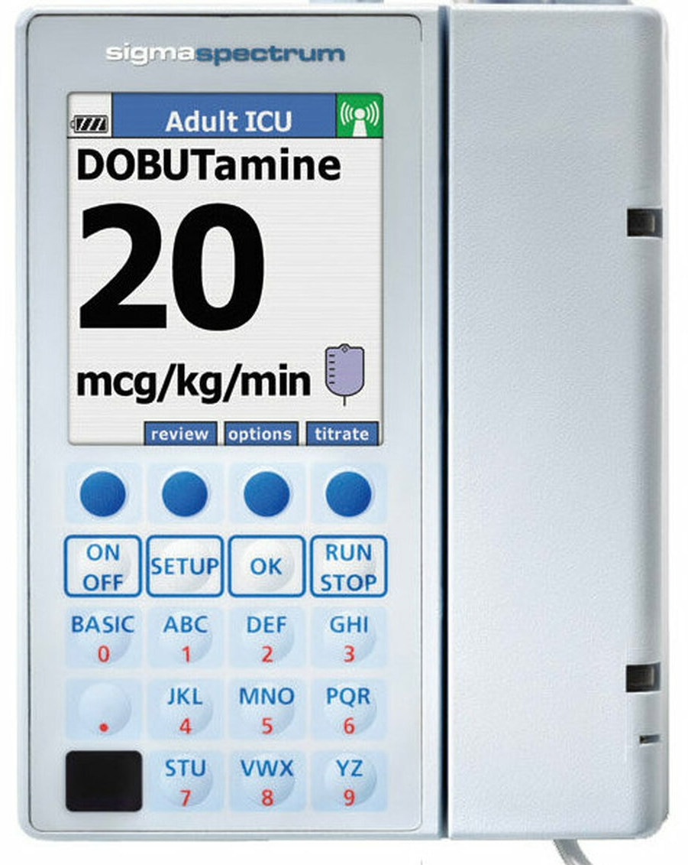



High Pressure Alarm Settings
High: 983 mmHg
Medium 672 mmHg
Low 310 mmHg
Default setting = Medium
(even lowest setting is very high!)

Slide 16
Recommendations
Obtain best, least vulnerable vein and secure carefully
Check IV with free flow before using (maintain high index suspicion esp with ward IV’s)
Recheck IV sites periodically
Avoid IV in tucked arm
If IV in tucked arm unavoidable, have more than 1 IV line
careful attention to IV when tucking arm
AVOID use of IV pump for main driving line (with high volumes)
If free flow stops, close off IV and don’t use
Awareness/education…
https://doi.org/10.1016/j.jclinane.2018.09.038

Slide 17
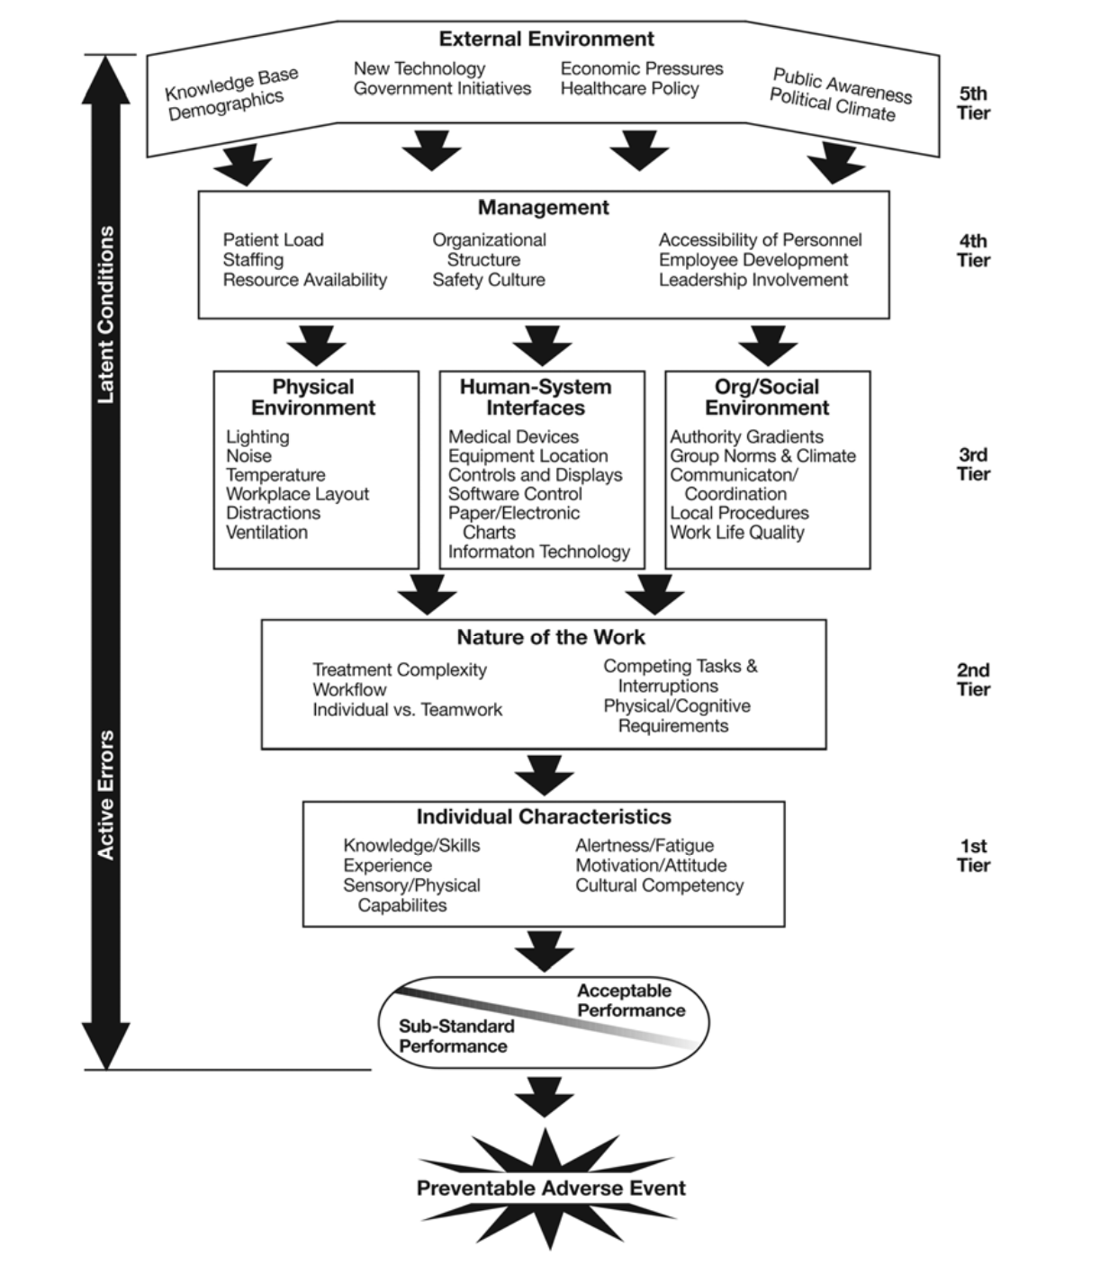
++ Contributing Factors
Use a framework to guide the investigative process
-chart review
-interviews
-equipment check
-protocol review, etc…
https://www.researchgate.net/publication/49843292_Understanding_Adverse_Events_A_Human_Factors_Framework

Slide 18
The End!

Slide 19
This work is licensed under CC BY-NC-SA 4.0. To view a copy of this license, visit: https://creativecommons.org/licenses/by-nc-sa/4.0/

